Slide 1



This story begins with
Let’s see what data say!
Can you buy an apartment to rent 3 and live in the 4rd one?

Slide 2

It’s is affordable to be a host in
?
?
?
?
?
?

Slide 3
Marketplace
You can upload your apartment/experience (places)
It’s easy, many places as you want
Their strategy is not to be a hotel is getting a place like your home
You’ll have an extra income
WTF is

Slide 4
What would be the right data to take
?
?
?
?
?
?

Slide 5
Extract, Transform, Load, repeat

Slide 6
Listings (Host Info)
Information Available
Calendars (Guest Info)
Reviews (Guest Info)

Slide 7
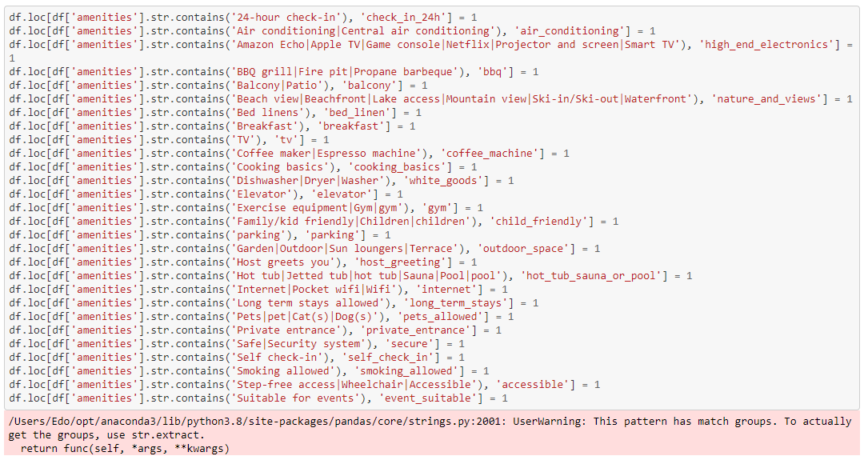
24hr check-in
Dishwasher
Beach view
Parking
Smoking allowed
Pets allowed

Slide 8
What have been found
?
?
?
?
?
?

Slide 9
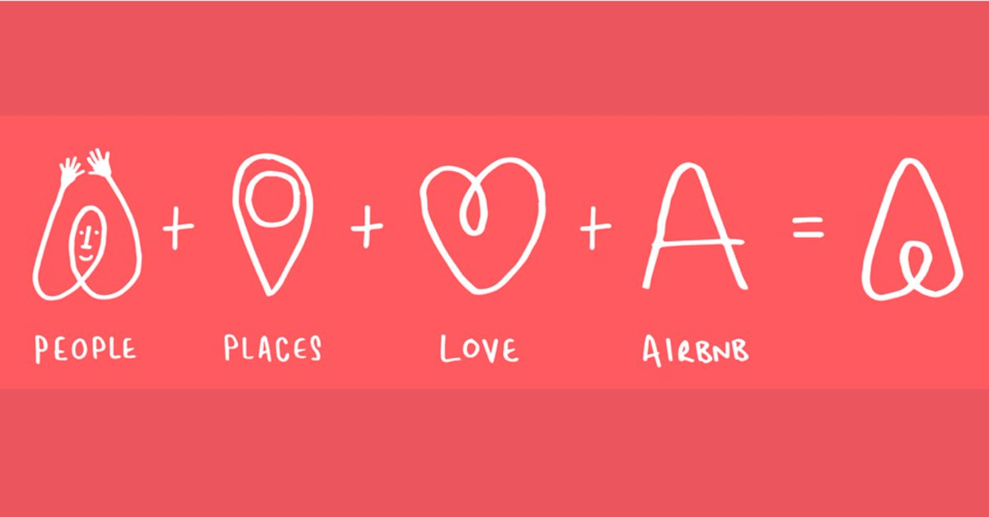

Slide 10
Trust

Slide 11
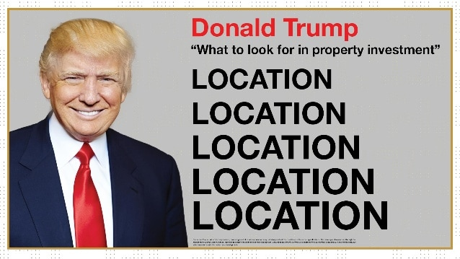
Location, Location, Location

Slide 12
Location, Location, Location
Data on Map 2
Data on Map 1

Slide 13
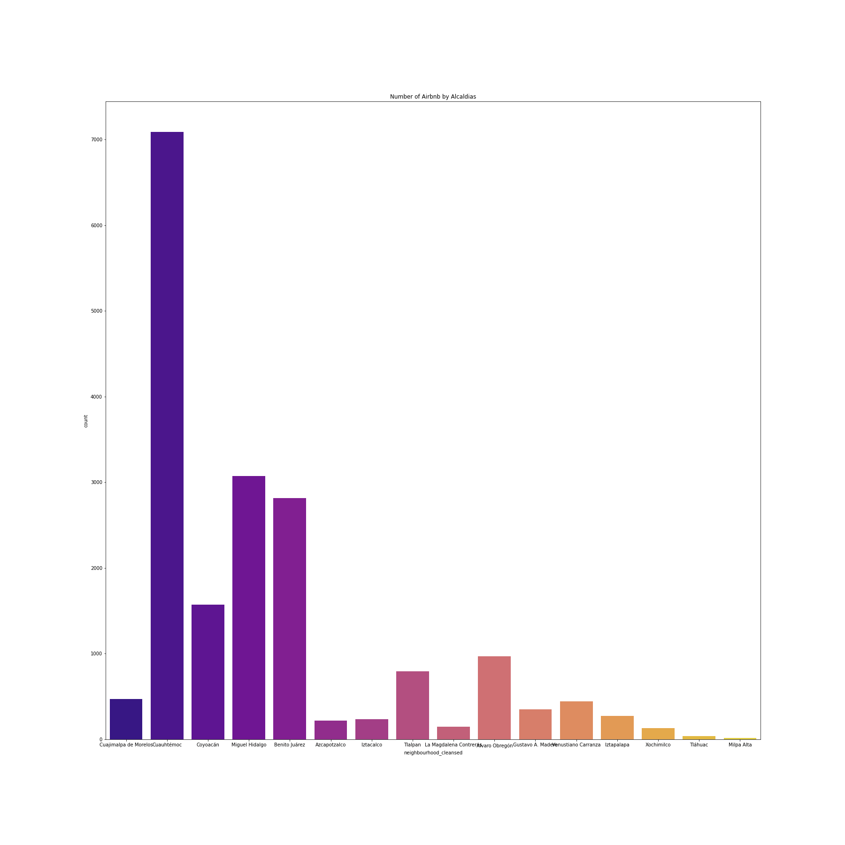
Location, Location, Location
Data on Map 2

Slide 14
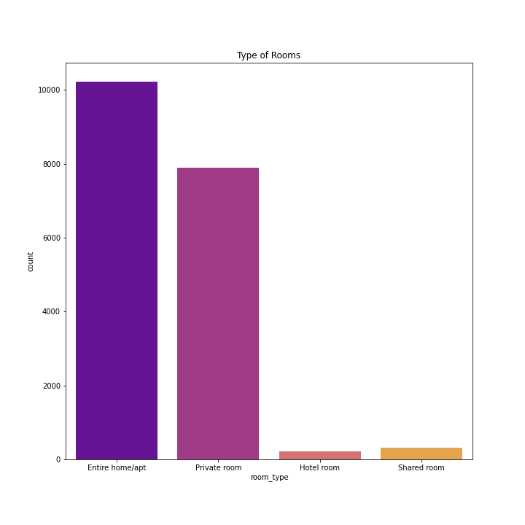

Slide 15

Voice of the people

Slide 16
The Machine Learning Model

Slide 17
Is the right model
?
?
?
?
?
?

Slide 18
Conclusions
Hosts and Guests have to trust each other.
2. Location and Features are above Price conditions
3. Some luxury features are not followed by guests.

Slide 19
Answering the question
Can you buy an apartment to rent 3 and live in the 4rd one?
Yes, if you have a high demanded place with the right features and the right price.

Slide 20
Thank you

